Slide 1

Capturing TCP Segments & UDP Datagrams using WINpcap API

Slide 2

What is Winpcap
pcap is an application programming interface (API) for capturing network traffic. While the name is an abbreviation of packet capture, that is not the API's proper name. Unix-like systems implement pcap in the libpcap library; for Windows, there is a port of libpcap named WinPcap that is no longer supported or developed, and a port named Npcap for Windows 7 and later that is still supported.
Monitoring software may use libpcap, WinPcap, or Npcap to capture network packets travelling over a computer network and, in newer versions, to transmit packets on a network at the link layer, and to get a list of network interfaces for possible use with libpcap, WinPcap, or Npcap.
The pcap API is written in C, so other languages such as Java, .NET languages, and scripting languages generally use a wrapper; no such wrappers are provided by libpcap or WinPcap itself. C++ programs may link directly to the C API or use an object-oriented wrapper.
https://en.wikipedia.org/wiki/Pcap

Slide 3
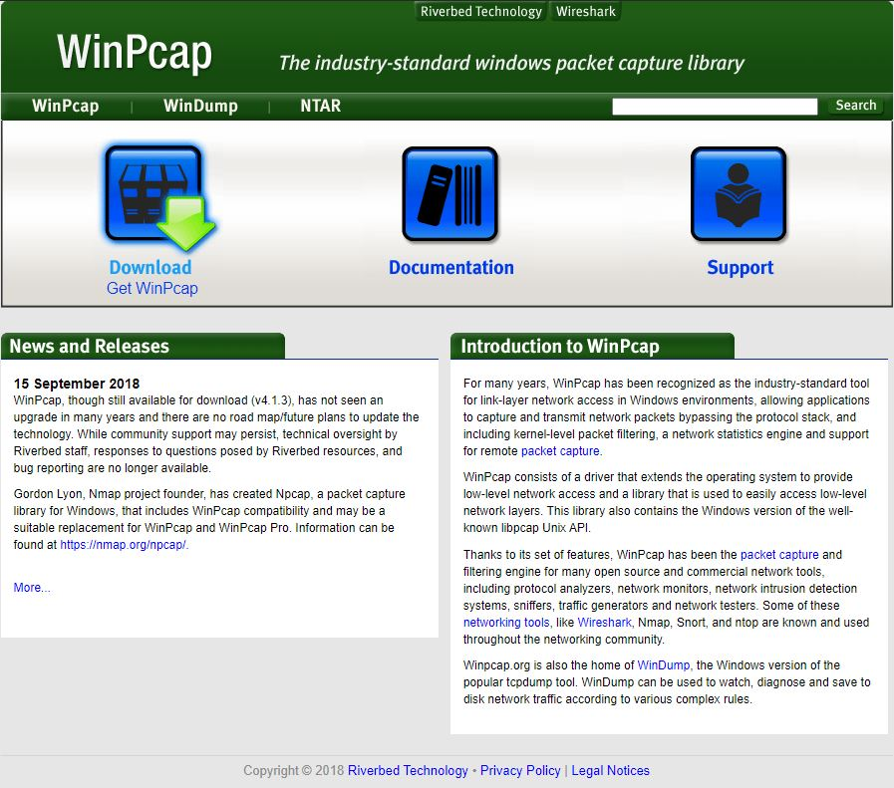
This is where you can get Winpcap from.
https://www.winpcap.org/
you can simply download it and follow the installation guide steps.

Slide 4
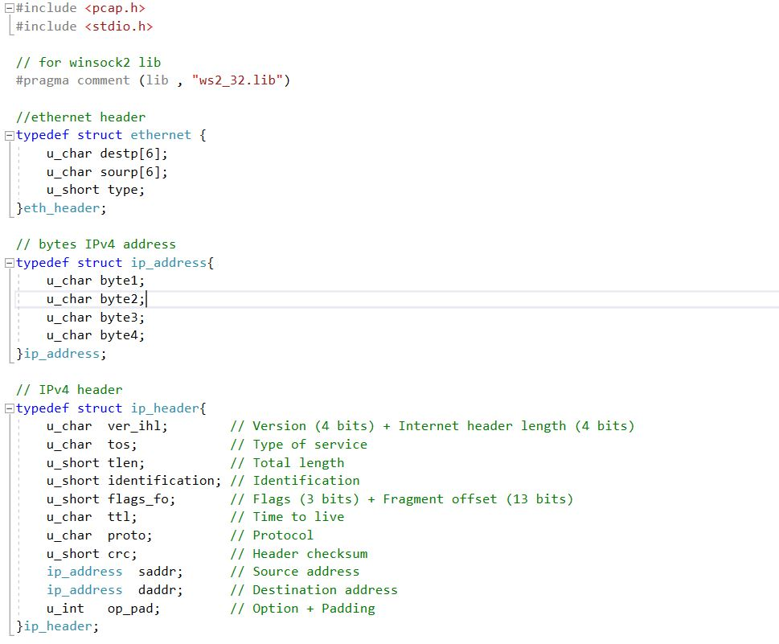
Now to capture the TCP and UDP header fields using Winpcap !

Slide 5
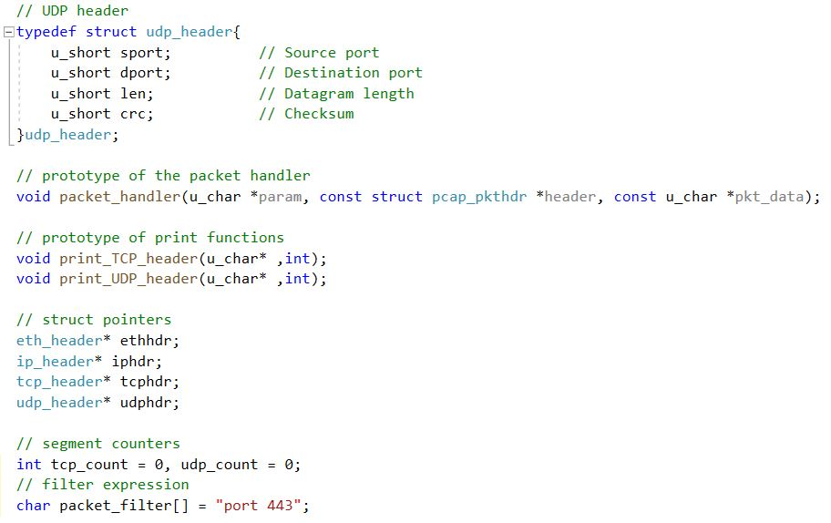
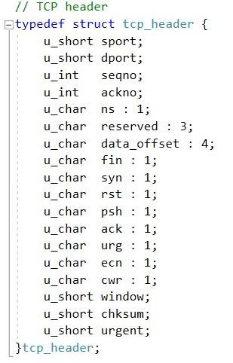

Slide 6
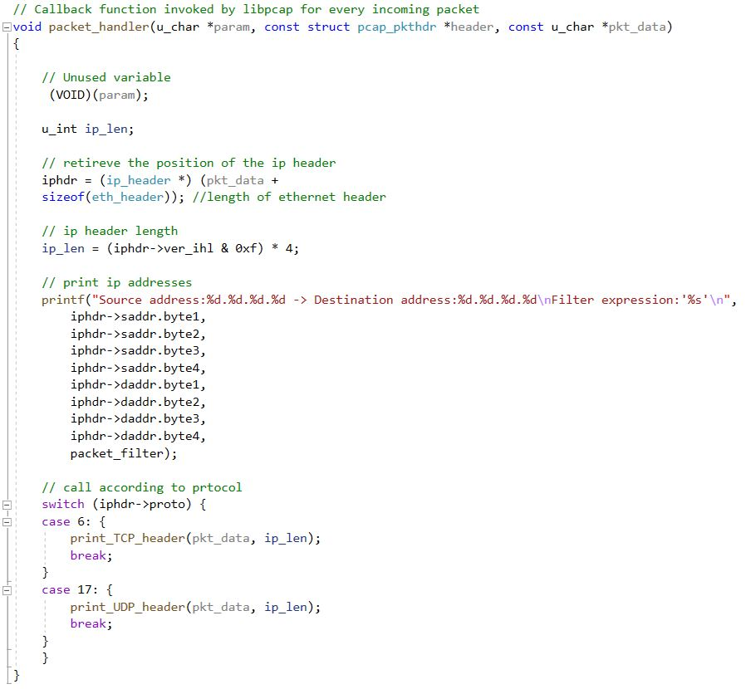

Slide 7
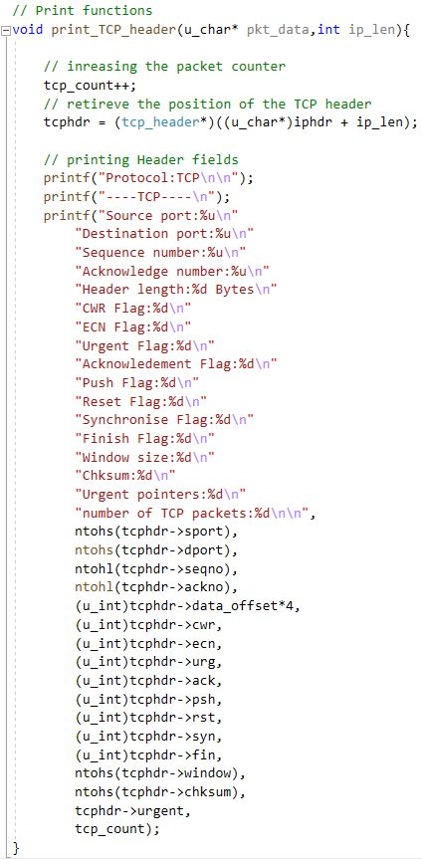
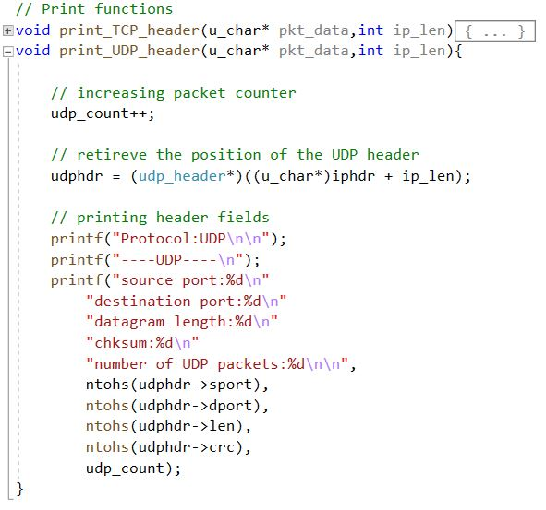

Slide 8
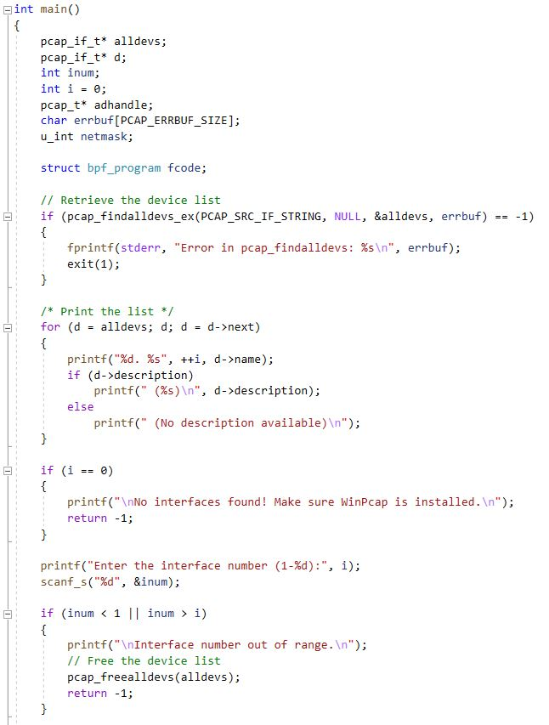
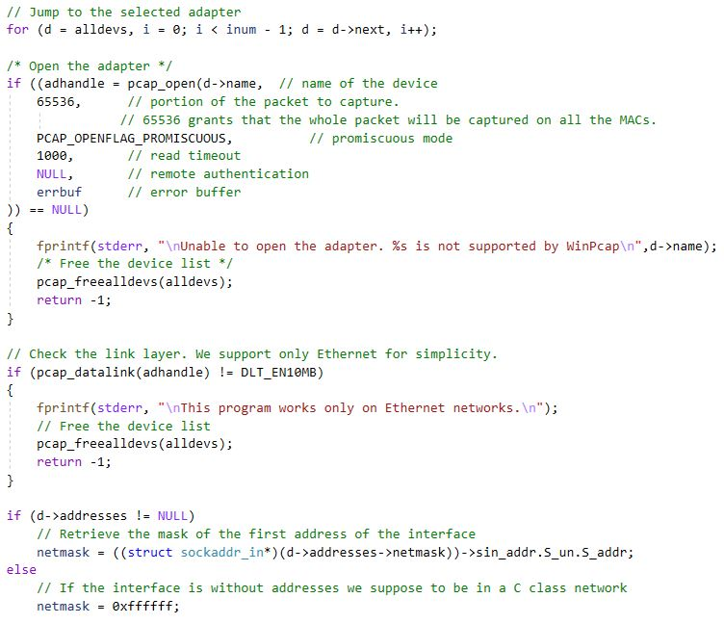

Slide 9
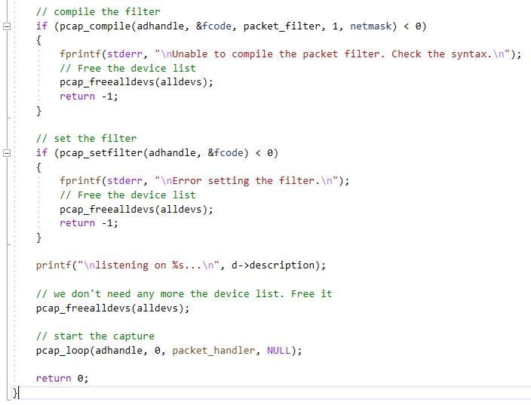

Slide 10



OUR TEAM:
MUHAMMED NUR ALDIN HALUBI
AHMAD ALKASEMI
GAZEL ELARYANI
2018556301
2018556304
2018556303

Slide 11
Thank You

